Slide 1
Good evening everybody
15 days online workshop
11th December, 2020-25th December,2020
Organized by :
GORKHA FOUNDATION

Slide 2
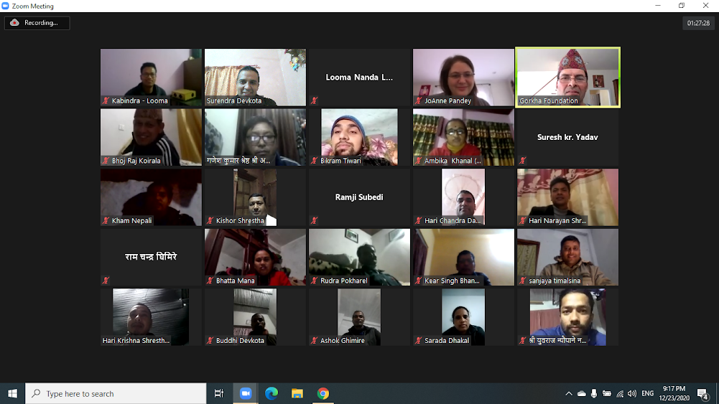
Our Group in the Training

Slide 3
ORGANIZERS
          Mr.Bijaya Devkota
          Director GORKHA FOUNDATION(America)
          Mrs.JoAnne Panday
          Programme Co-ordinator Gorkha Foundation (America)
          Facilitator:
          Mr. Surendra Devkota (Nepal)

Slide 4
Special thanks to:
Mr. Bijaya Devkota
Mrs JoAnne Panday
For providing this opportunity, facilitating, monitoring, encouraging and providing feedback.
Mr. Surendra Devkota
For the wonderful facilitation and supporting role during the training

Slide 5
Thank you all participants teachers from these schools:
Amar Jyoti Janata Secondary School
Mahendra Sansari Secondary School
Mandali Secondary School
Nepane Secondary School
Paropakar Secondary School
Sharada Secondary School

Slide 6
Special features of the training
Revision of previous training
Presentation of our materials
Presentation of wonderful and nice photograph by Bijaya Sir related to Gorkha , especially remote areas, life style, education and beauty of nature.
Get information about new topics
Basic Knowledge of ICT for the begginers
Demand based learning
Practical training (learning by doing)
Construction of instructional materials based on ICT
Facilitation by the participants.
Encouragement and providing feedback immediately

Slide 7
Positive aspects of the training
Opportunities to learn more things related to distance learning.
Organized systematically
Basic course for beginners
Including of important new topics
Facilitation by participant teachers
Demand based learning
Encouragement to learn by doing
Presentation of self made materials
Providing feedback

Slide 8
What we learned during the training
Use ICT tools for teaching learning activities, online teaching or direct teaching
Get knowledge about various applications and software such as google earth, Jamboard, Google maps , eClass Nepal and other tools as well as use them.
Prepare grade-sheet and mark-sheet which is very essential and useful in our teaching life.
Search the materials from google and youtube and construct the essential instructional materials of our own.
Use various google apps such as Zoom, Google classroom and others for distance learning.

Slide 9
We hope that :
We use the knowledge which we were provided here in our teaching learning activities of the classroom.
It will be fruitful to us as well as our students.
Gorkha Foundatioin will provide such opportunities or such programmes related to education in future.
We share our knowledge and skills with other teachers who were not be able to attend the training.
Documentation of our materials is another activities we have to do to protect and share our creation.

Slide 10
Any feedback ?
The number of participants .
Disturbance of network .
Technical problem.

Slide 11
We would like to thank again:
Gorkha Foundation
For organizing such programmes for improving quality in education in Gorkha.

Slide 12


